Slide 1
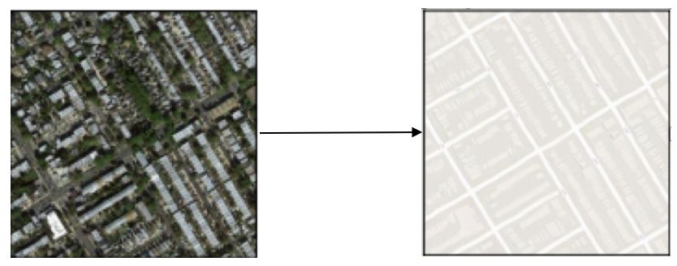

Cycle GAN: Unpaired Image-to-image Translation
Zhaokai Huang

Slide 2
Roadmap
Recap
Image-to-image Translation
Conditional GAN
Cycle GAN
…
Directions

Slide 3
Recap
Generative Adversarial Networks (GANs)
Generator
X ~ G(z)
Discriminator
Real or Fake

Slide 4
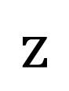
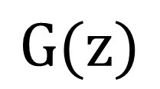

$$z$$
$$G(z)$$
$$G$$
Generator

Slide 5


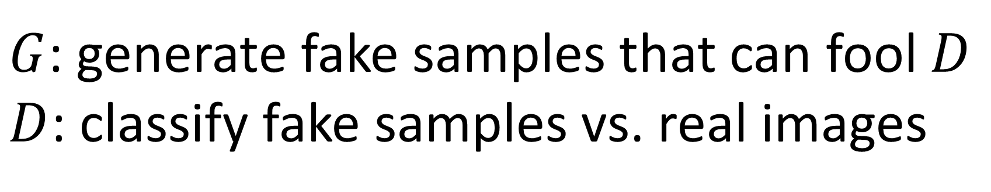
$$z$$
$$G(z)$$
$$G$$
$$D$$
real or fake?
Generator
Discriminator
$G$: generate fake samples that can fool $D$
$D$: classify fake samples vs. real images

Slide 6
$$z$$
$$G(z)$$
$$G$$
$$D$$
fake 0.1

Slide 7
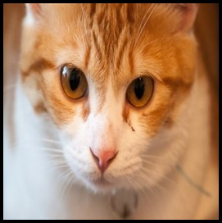

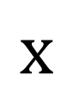
$$z$$
$$G(z)$$
$$G$$
$$D$$
fake 0.1
$$x$$
$$D$$
real 0.9

Slide 8
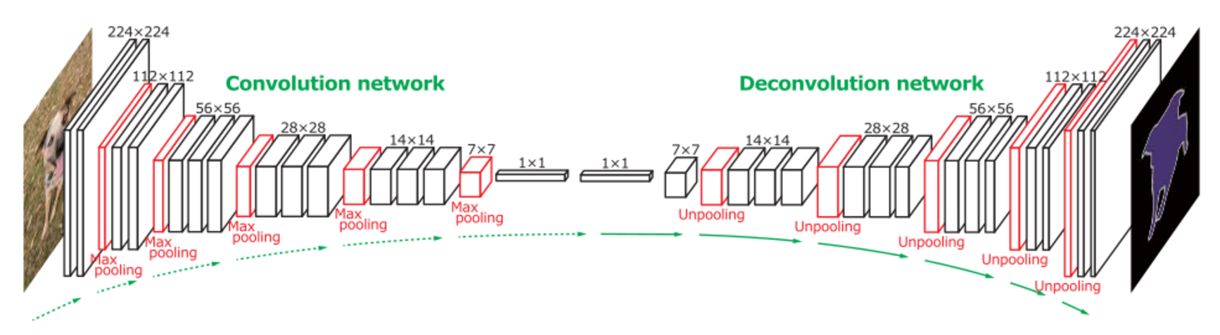
DCGAN Example

Slide 9
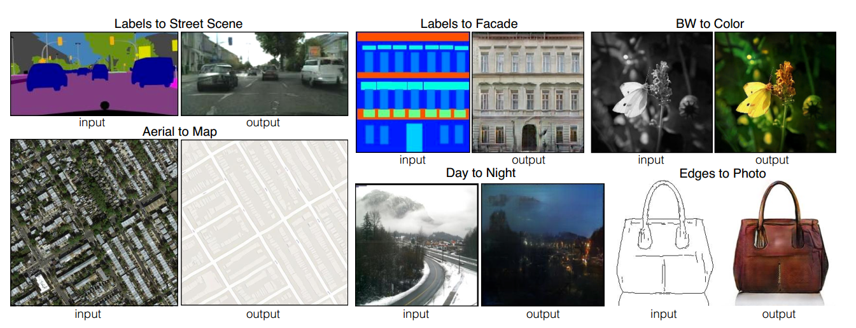
Image-to-Image Translation
Image-to-image translation with conditional adversarial nets [Isola, Zhu, Zhou, Efros. CVPR 2017]

Slide 10
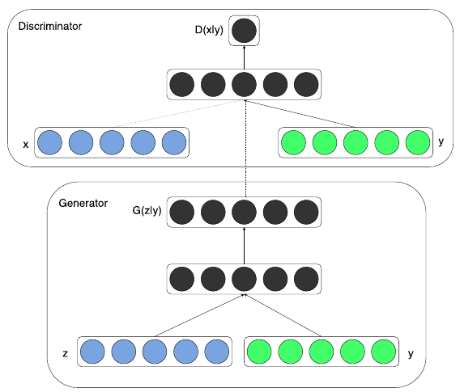
Conditional GAN

Slide 11
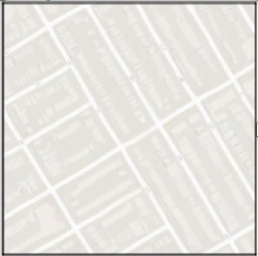
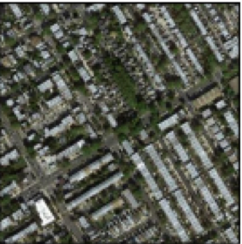
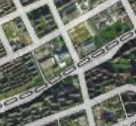
Input (y)
Conditional features
Output (G(z|y))

Slide 12
Cycle GAN

Slide 13
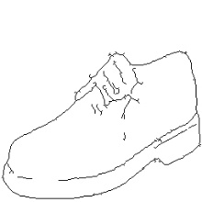
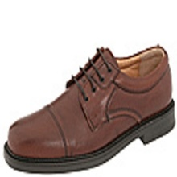
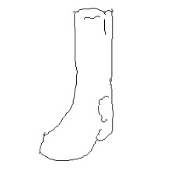
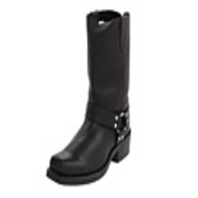
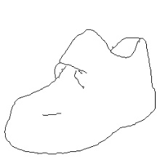
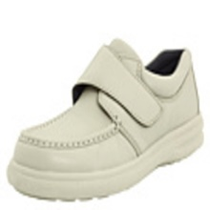
Paired
…

Slide 14
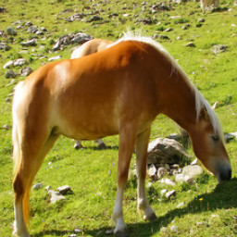
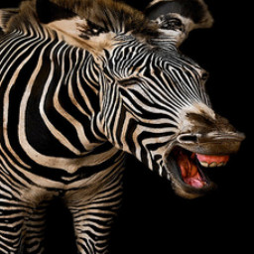
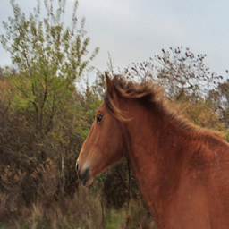
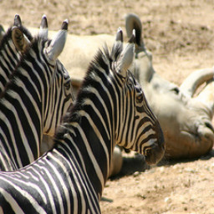
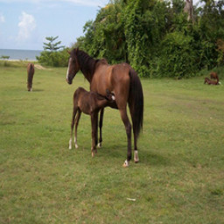
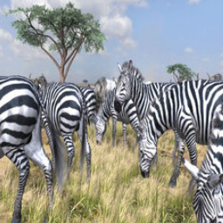
Paired
Unpaired
…
…
…

Slide 15
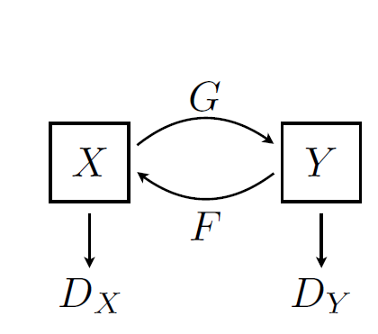

Unpaired Image-to-image translation using cycle-consistent adversarial networks
Discriminator $D_{Y}$: $L_{GAN}\left(G\left(x\right),y\right)$
Real zebras vs. generated zebras
…
…
…
[Zhu*, Park*, Isola, Efros on arxiv]

Slide 16

Unpaired Image-to-image translation using cycle-consistent adversarial networks
Discriminator $D_{Y}$: $L_{GAN}\left(G\left(x\right),y\right)$
Real zebras vs. generated zebras
…
Discriminator $D_{X}$: $L_{GAN}\left(F\left(y\right),x\right)$
Real horses vs. generated horses
…

Slide 17
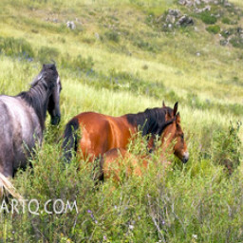
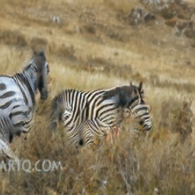

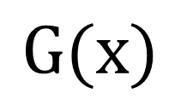


$$x$$
$$G(x)$$
$$G$$
$$D$$
Real!
Generator
Discriminator
.
.
.
N mapping functions,
N possible results.

Slide 18
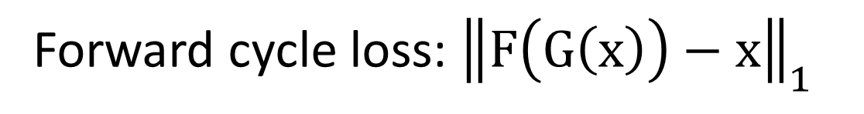
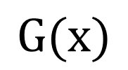
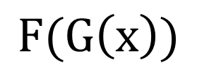
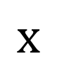
Cycle-consistency Loss
Forward cycle loss: ${\left\|F\left(G\left(x\right)\right)−x\right\|}_{1}$
$$x$$
$$G(x)$$
$$F(G\left(x\right))$$

Slide 19
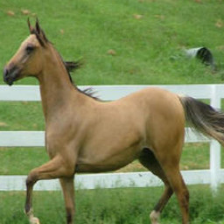
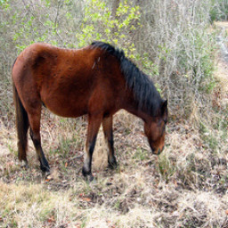
Cycle-consistency Loss
Forward cycle loss: ${\left\|F\left(G\left(x\right)\right)−x\right\|}_{1}$
Large cycle loss
Small cycle loss
$$x$$
$$G(x)$$
$$F(G\left(x\right))$$

Slide 20
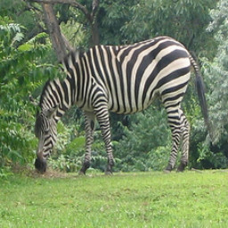
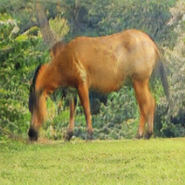
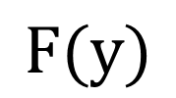
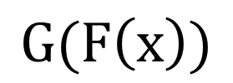
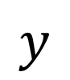
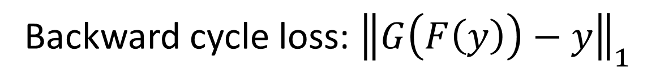
Cycle-consistency Loss
Forward cycle loss: ${\left\|F\left(G\left(x\right)\right)−x\right\|}_{1}$
Backward cycle loss: ${\left\|G\left(F\left(y\right)\right)−y\right\|}_{1}$
$$x$$
$$G(x)$$
$$F(G\left(x\right))$$
$$y$$
$$F(y)$$
$$G(F\left(x\right))$$

Slide 21
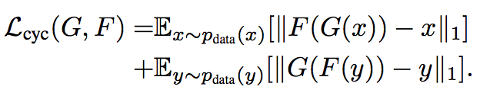
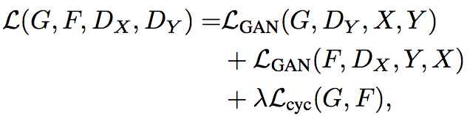
Objective Function
Cycle Loss,
Full Objective,

Slide 22
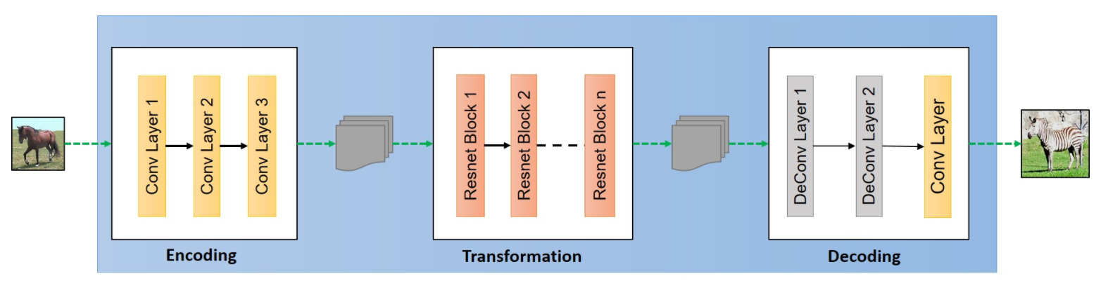
Architecture - generator

Slide 23
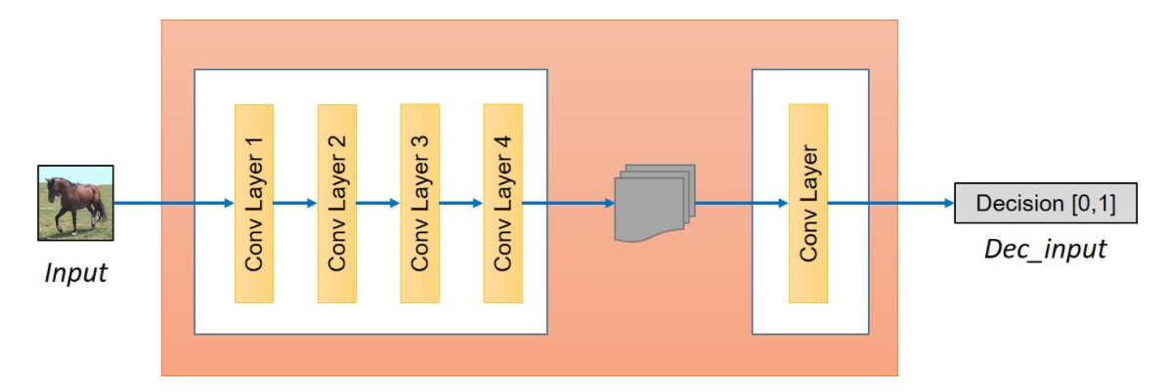
Architecture - discriminator

Slide 24
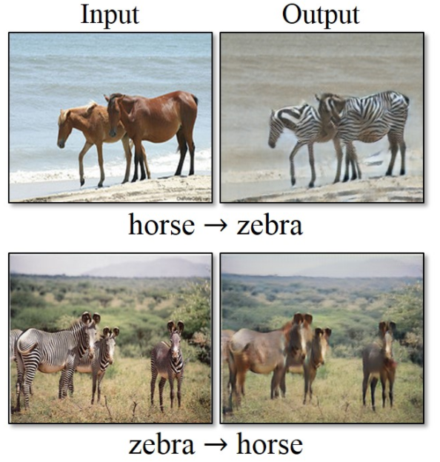
Applications

Slide 25
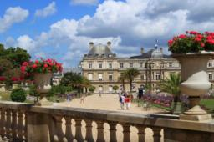
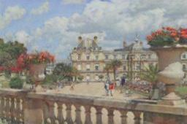
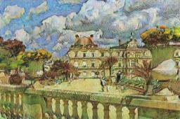
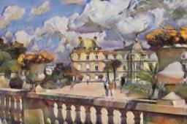
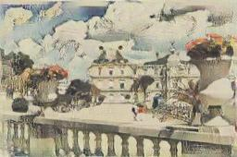















Input
Monet
Van Gogh
Cezanne
Ukiyo-e

Slide 26









Slide 27
Directions
Imitation Learning
Neural Dialogue Generation
IRGAN (Information Retrieve, Alibaba)

Slide 28
Thanks! Q&A?

